Slide 1
Chapter 2.2 Creating High-Quality Code
CCSW 325 (Software Construction)
Notes:
Last Update: 22/8/2019
Version 1.0

Slide 2
Outline
Design in Construction – Part 1 of 2
Key Design Concepts

Slide 3
Software Design
Its the activity that links requirements to coding and debugging.
Turning a specification for computer software into operational software.
A good top-level design provides a structure that can safely contain multiple lower-level designs

Slide 4
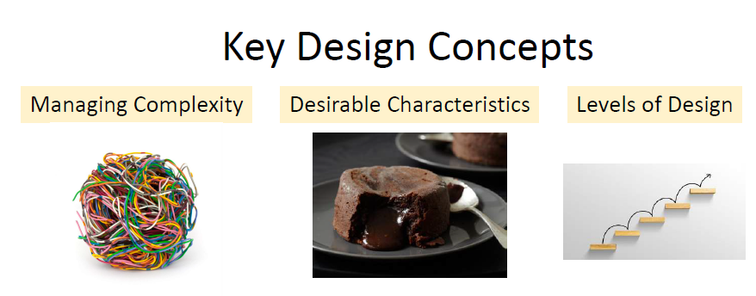

Slide 5


Managing Complexity:
Software development is made difficult because of two different classes of problems:
the essential and the accidental
Fred Brooks’s landmark paper, “No Silver Bullets: Essence and Accidents of Software Engineering” (1987).
The properties that a thing must have in order to be that thing
The properties a thing happens to have and don’t really bear on whether the thing is what it is
Engine,
Wheels, and
Doors
Two doors or four;
Skinny wheels or
Mag wheels

Slide 6

Managing Complexity:
Importance of Managing Complexity
When projects do fail for reasons that are primarily technical, the reason is often uncontrolled complexity.
The goal is to minimize the amount of a program you have to think about at any one time.
Dividing the system into subsystems
Break a complicated problem into simple pieces
More independent the subsystems
Keeping routines short

Slide 7
Managing Complexity:
How to Attack Complexity
Minimize the amount of essential complexity that anyone’s brain has to deal with at any one time
Keep accidental complexity from needlessly proliferating
Notes:
Needlessly Proliferating: complexity should not be allowed to grow or spread unnecessarily throughout the software system. In other words, it's important to avoid introducing complexity that doesn't provide significant value or is not required to address the problem at hand.

Slide 8
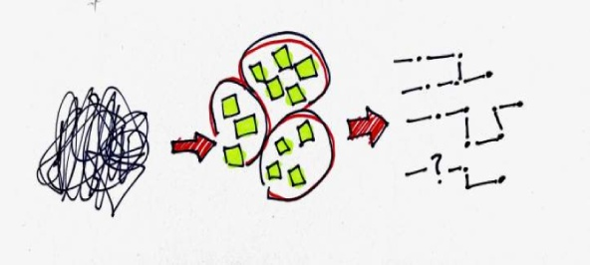




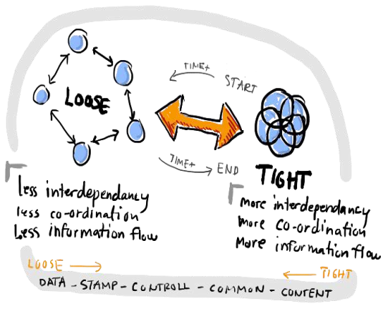




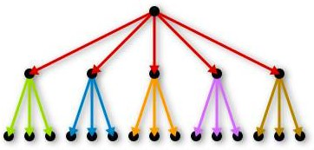

Desirable Characteristics of a Design
Minimal Complexity
Ease of Maintenance
Extensibility
Reusability
Portability
Make “simple” and “easy-to-understand” designs
Design the system to be self-explanatory
Change a piece of a system without affecting other pieces
Reuse pieces of
it in other systems
Easily move it to
another environment
Loose Coupling
Leanness
High Fan-In
Low-to-Medium Fan-Out
Design classes with as few interconnections as possible
No extra parts
A system has been designed to make good use of utility classes at the lower levels in the system
A given class use a low-to-medium number of other classes
Design the system so that you can view it at one level without dipping into other levels
Using standardized, common
approaches
Stratification
Standard Techniques

Slide 9
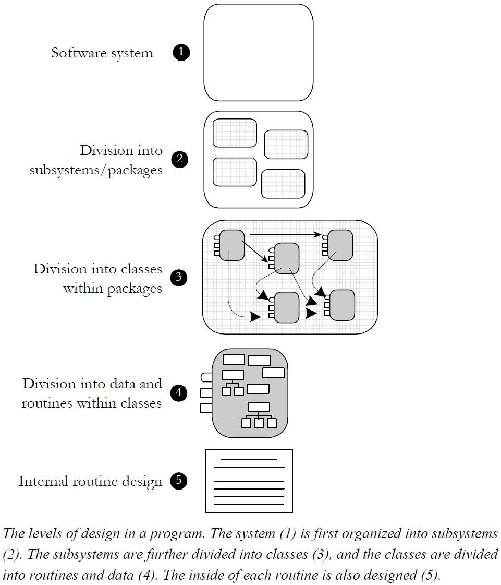
Level of Design
Design is needed at several different levels of detail in a software system. Some design techniques apply at all levels, and some apply at only one or two.

Slide 10
Level of Design
❶ Software System
The first level is the entire system. Some programmers jump right from the system level into designing classes, but it’s usually beneficial to think through higher level combinations of classes, such as subsystems or packages.

Slide 11
Level of Design
❷ Division into Subsystems or Packages
The major design activity at this level is deciding how to partition the program into major subsystems and defining how each subsystem is allowed to use each other subsystem.
Within each subsystem, different methods of design might be used—choosing the approach that best fits each part of the system.
User interface
May use several subordinate subsystems or
classes for the GUI interface, command line interface, menu operations, window management, help system, and so forth
Business Rules
the laws, regulations, policies,
and procedures that you encode into a computer system
Common Subsystems
Database Access
centralize database operations in
one place and reduce the chance of errors in working with the data.
System dependencies
If you're developing a program for
Microsoft Windows, why limit yourself to the Windows environment? Isolate the Windows calls in a Windows-interface subsystem. If you later want to move your program to Mac OS or Linux, all you'll have to change is the interface subsystem

Slide 12


Level of Design
❸ Division into Classes within Packages
Design at this level includes identifying all classes in the system.
Object Oriented Programming

Slide 13
Level of Design
❹ Division into Data & Routines within Classes
When you examine the details of the routines inside a class, you can see that many routines are simple boxes but a few are composed of hierarchically organized routines, which require still more design.

Slide 14
❺ Internal Routine Design
Design at the routine level consists of laying out the detailed functionality of the individual routines. The design consists of activities such as writing pseudo-code, looking up algorithms in reference books, deciding how to organize the paragraphs of code in a routine, and writing programming-language code.
Internal routine design is typically left to the individual programmer working on an individual routine.

Slide 15

Reading
Code Complete: A Practical Handbook of Software Construction, 2nd Edition, Steve McConnell.
Chapter 5

Slide 16

Any questions? ​
Please feel free to raise your hands and ask.

